Slide 1
FINAL CAPSTONE PROJECT

Slide 2
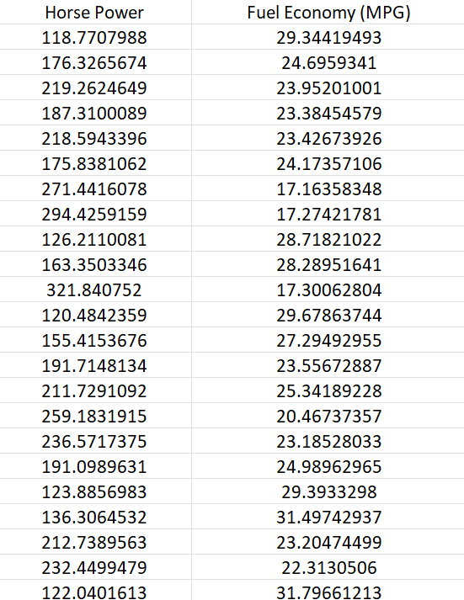
FINAL CAPSTONE PROJECT
You have been hired as a consultant to a major Automotive Manufacturer and you have been tasked to develop a model to predict the impact of increasing the vehicle horsepower (HP) on fuel economy (Mileage Per Gallon (MPG)). You gathered the following dataset:
Using the skeleton jupyter notebook “Simple Linear Regression - Fuel Consumption Project Questions”, perform the following:
Independent variable X: Vehicle Horsepower
Dependent variable Y: Mileage Per Gallon (MPG)
1. Load the “FuelEconomy.csv” dataset
2. Perform data visualization and basic exploratory data analysis
3. Split the data into 80% for training and 20% for testing
4. Train a machine linear regression model in Scikit-Learn
5. Assess trained model performance

